Slide 1
SYMPTOM CHECKER ai agent
IBM SKILLBUILD PROJECT
Presented By:
Student name :Rakshit
College Name & Department :Jaypee Institute of Information technology, ECE depatment

Slide 2
OUTLINE
Problem Statement
Technology used
Wow factor
End users
Result
Conclusion
Git-hub Link
Future scope
IBM Certifications

Slide 3
Problem Statement
The Challenge – An Agentic AI Health Symptom Checker helps users understand their health conditions by analyzing symptoms and providing probable causes, preventive advice, and care recommendations. It retrieves verified medical data, symptom databases, and guidelines from trusted sources like WHO, government health portals, and medical journals. Users can input symptoms in natural language such as “I have a sore throat and fever,” and the agent provides possible conditions, urgency level, home remedies, and when to consult a doctor. It supports multi-language interaction and avoids self-diagnosis risks by offering educational and referral-based suggestions. This AI-driven assistant promotes early detection, reduces misinformation, and empowers users to take informed health actions.

Slide 4
Technology used
IBM cloud lite services
Natural Language Processing (NLP)
Retrieval Augmented Generation (RAG)
IBM Granite model

Slide 5
IBM cloud services used
IBM Cloud Watsonx AI Studio
IBM Cloud Watsonx AI runtime
IBM Cloud Agent Lab
IBM Granite foundation model

Slide 6
Wow factors
The "wow factor" in symptom checker AI agents comes from several advanced and impactful features that elevate the patient experience and healthcare efficiency:
Human-like natural conversations: Unlike simple symptom check websites, AI agents engage patients in detailed, natural language interactions, using voice or text input. This deeper dialogue helps better understand symptoms and patient context.
Extensive medical knowledge integration: These AI systems reference large, clinically validated databases covering hundreds of medical conditions (700+ in some cases), enabling highly comprehensive and accurate assessment.
Precise symptom assessment and triage: They can generate differential diagnoses prioritized by severity and urgency, providing immediate recommendations such as self-care, virtual consultation, specialist referral, or emergency action.
24/7 accessibility and scalability: AI agents operate around the clock, handling multiple patients simultaneously and providing fast, on-demand medical advice even when clinics are closed or overwhelmed.

Slide 7
End users
Patients and General Public
Healthcare Providers
Health Insurance Companies and Health Plans
Public Health Organizations and Governments
Caregivers and Family Members
Employees and Occupational Health Services

Slide 8
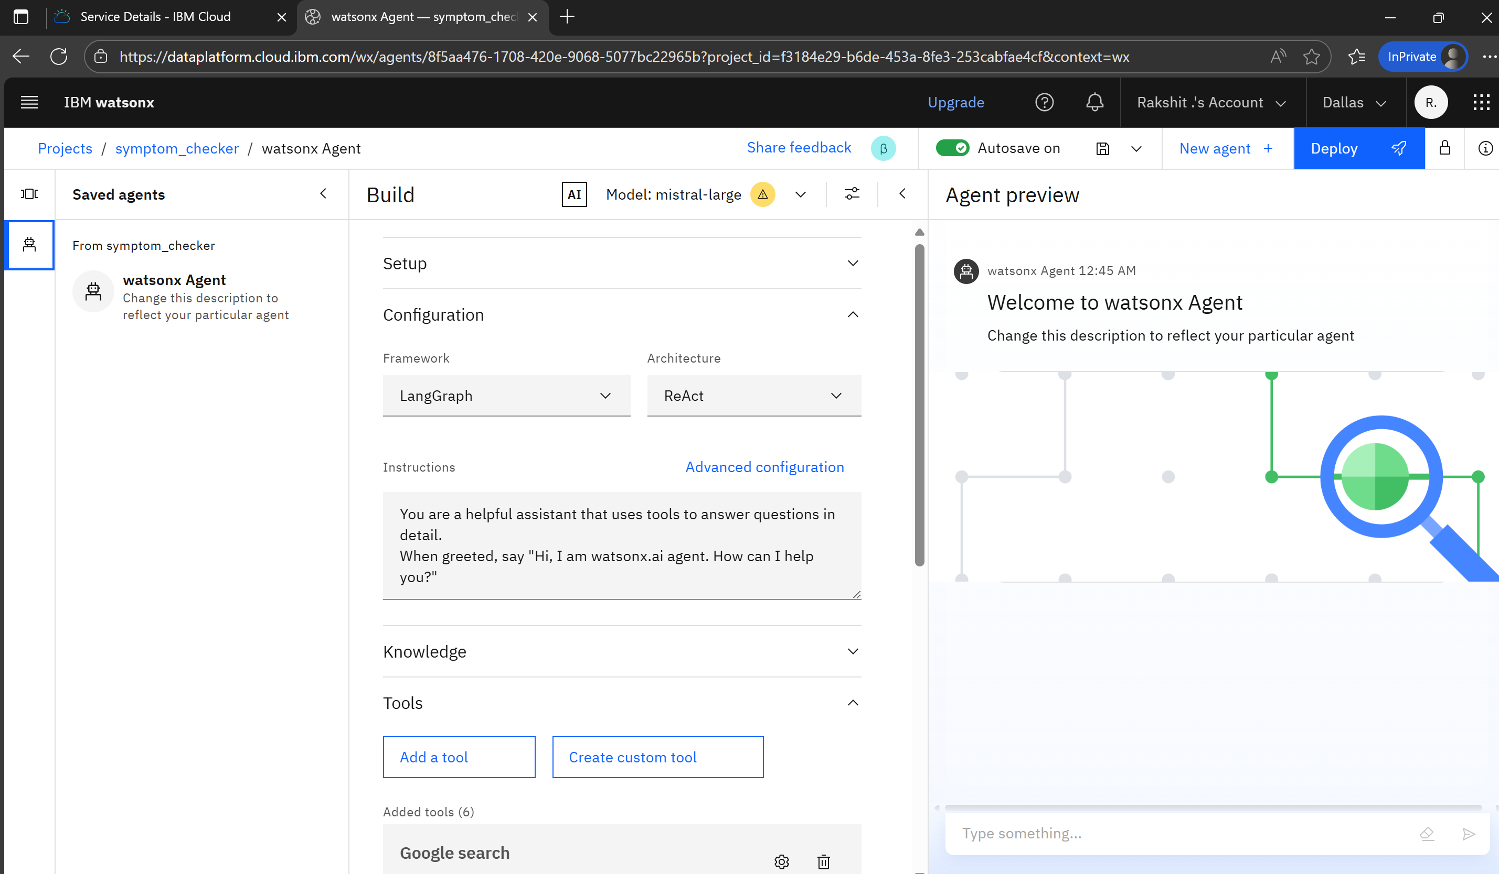
Results

Slide 9
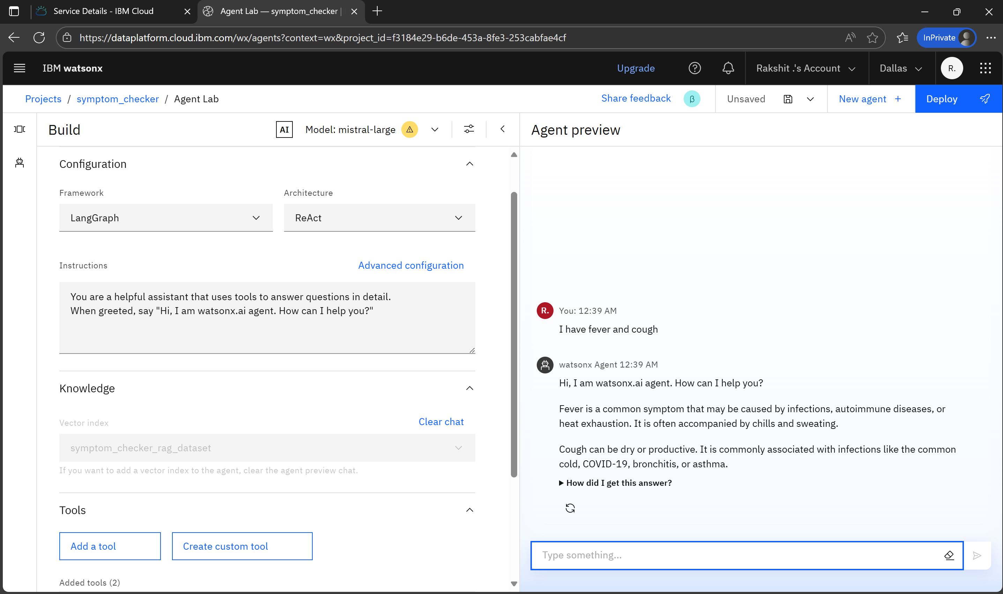
Results

Slide 10
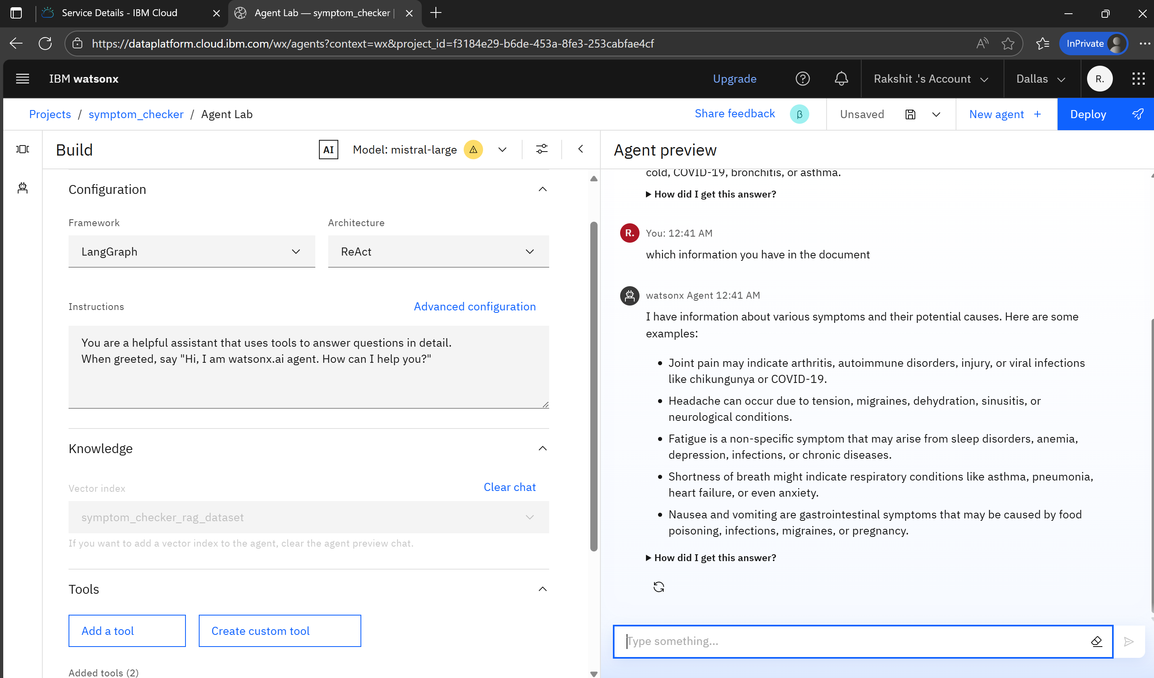
Results

Slide 11
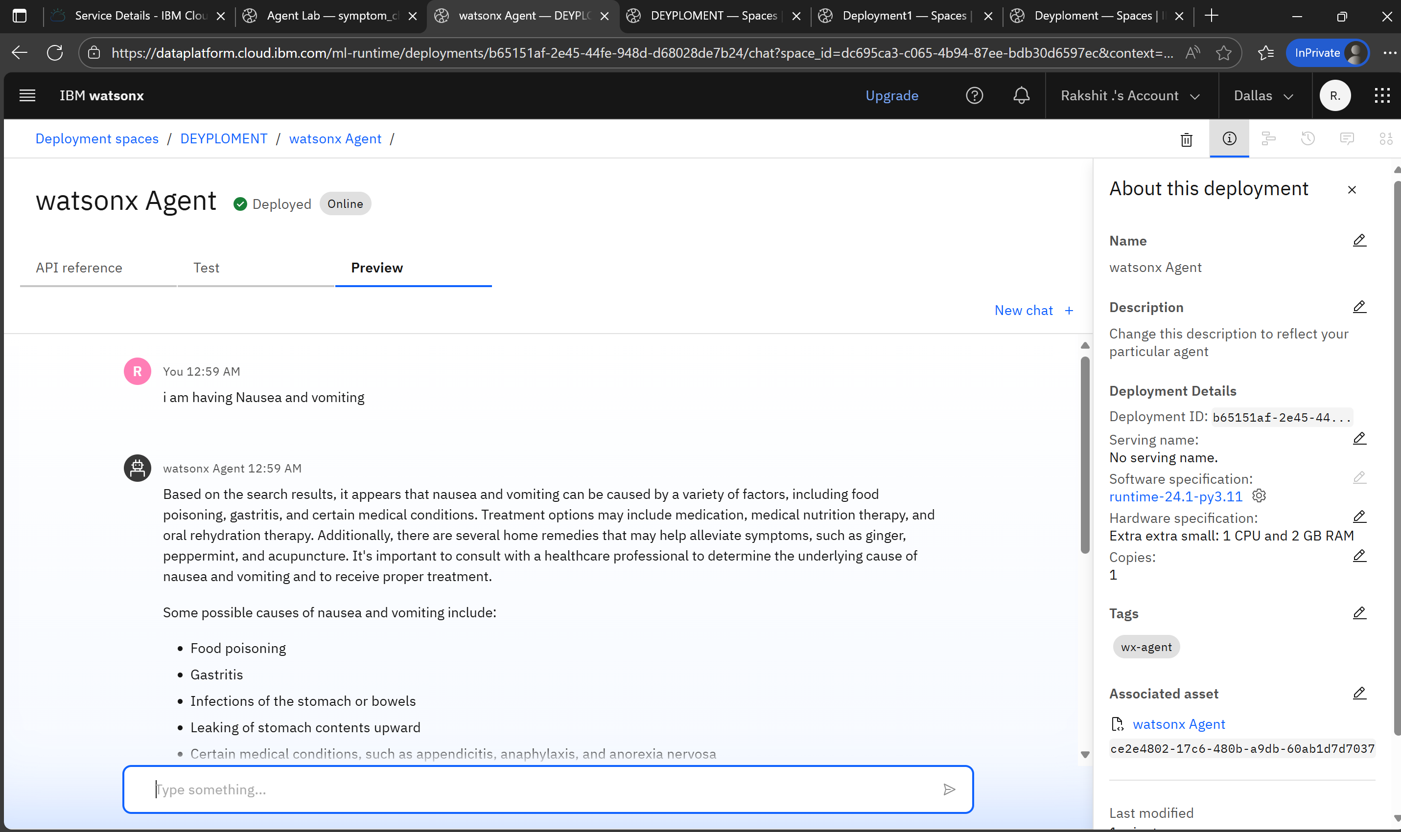
Results
Deployed AI Agent

Slide 12
Conclusion
Here is a concise conclusion on symptom checker AI agents in points:
Provide quick, 24/7, accessible symptom assessment and guidance using natural language interaction.
Draw from extensive medical databases and AI to deliver accurate, personalized symptom analysis and triage.
Help patients identify the urgency of their symptoms and direct them to the right care level (self-care, telemedicine, specialist, emergency).
Reduce unnecessary clinic or emergency visits, easing healthcare system burdens and cutting costs.
Improve patient experience by simplifying symptom checking and appointment scheduling digitally, avoiding long waits and phone menus.

Slide 13
GitHub Link
https://github.com/rakshit4100/symptom-checker-.git

Slide 14
Future scope
Enhanced Diagnostic Accuracy with Advanced AI Models
Integration with Wearable and IoT Health Devices
Personalized and Predictive Healthcare Recommendations
Expansion of Multilingual and Multimodal Interfaces
Real-time Monitoring and Chronic Disease Management

Slide 15
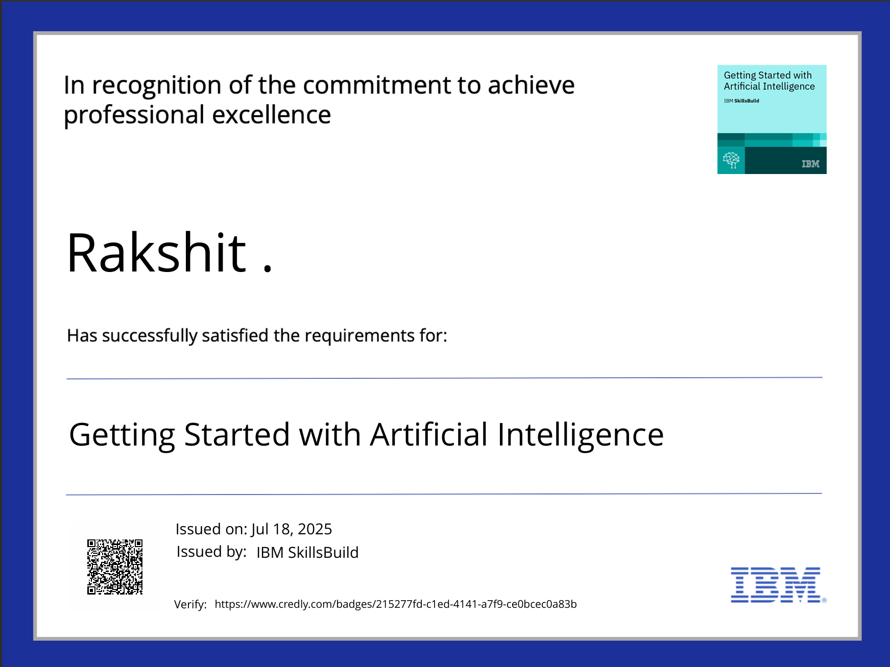
IBM Certifications
Credly certificate( getting started with AI)

Slide 16
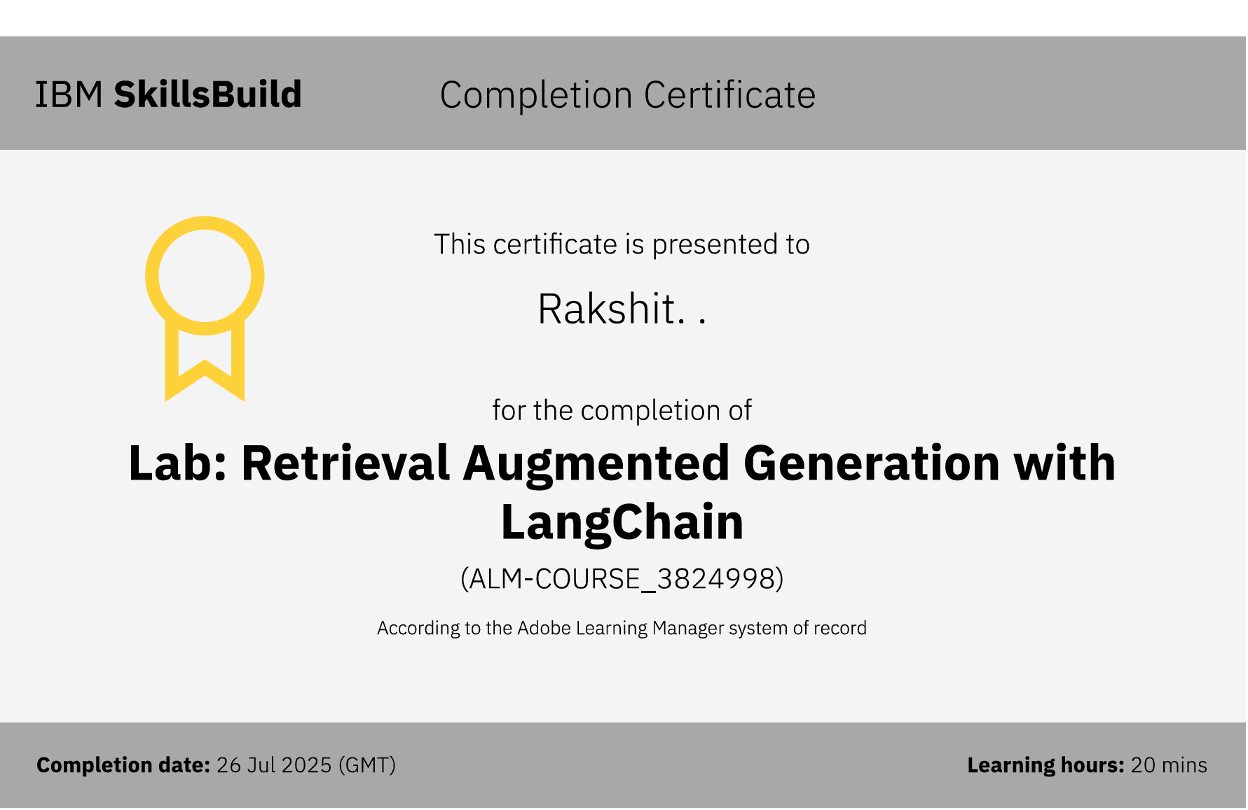
RAG LAB certificate

Slide 17
THANK YOU

